Slide 1
Accessing your HEAR
Register with Gradintelligence on the link provided on your registration email.
If you are eligible and do not receive a registration email please contact us at hear@keele.ac.uk

Slide 2
Accessing your HEAR
Once you have received your registration email from Gradintelligence, please click on the link to follow the registration process and choose your username and password.

Slide 3
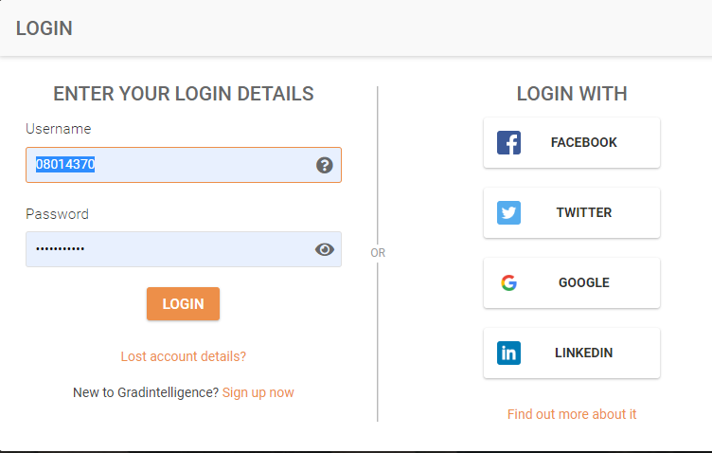
Accessing your HEAR
Once you have completed your registration please visit www.gradintel.com to log on
You will be prompted to
change your contact email
address to your personal
email account

Slide 4
Accessing your HEAR
Once logged in click on University Services

Slide 5
Accessing your HEAR
Click on Official Documents

Slide 6
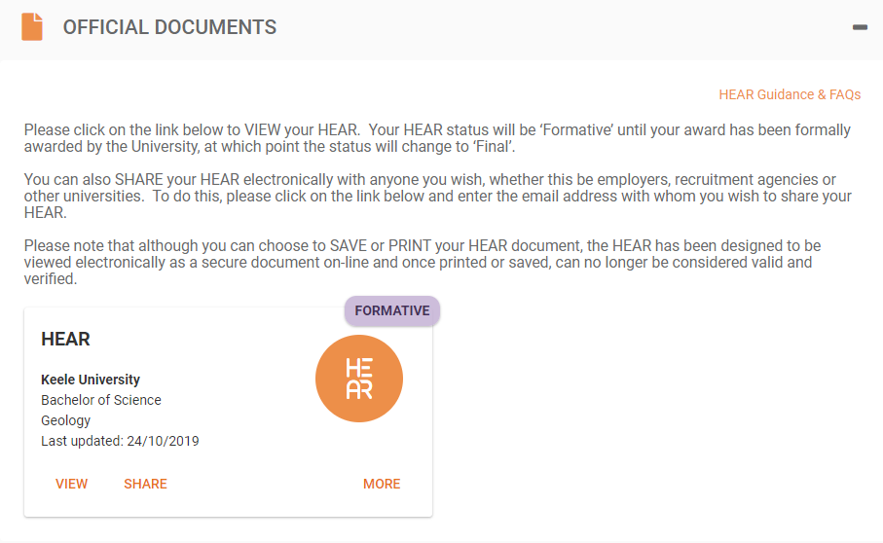
Accessing your HEAR
Once in Official Documents select ‘VIEW’ to view your HEAR

Slide 7
Sharing your HEAR 1
You can share your HEAR by clicking on ‘SHARE’ which will send an electronic token
via email to your
chosen
recipient.

Slide 8
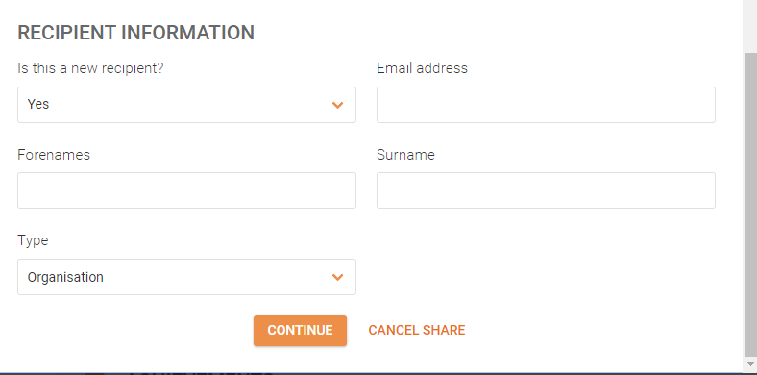
Sharing your HEAR 2
Fill in the share request form
Share with an existing recipient or a new recipient

Slide 9
Sharing your HEAR 3
Choose your recipient and share

Slide 10
Activities
You can view your co-curricular activities by clicking on Achievements

Slide 11
Careers
Further information from the Careers and Employability Team and how you can use them in conjunction with Gradintelligence can be found by clicking on Careers

Slide 12
Questions?
If you have any questions please visit our website www.keele.ac.uk/hear
Email us at hear@keele.ac.uk
For further information about the employability features of the Gradintelligence website please contact careers@keele.ac.uk

